Slide 1


HTML Tables

Slide 2
Table
A table is made up of rows and columns. The intersection of each row and column is called as a cell.
A row is made up of a set of cells that are placed horizontally.
A column is made up of set of cells that are placed vertically.

Slide 3
Table Tag Hierarchy
<table>
<thead>
<tr>
<th> </th>
</tr>
</thead>
<tbody>
<tr>
<td> </td>
</tr>
</tbody>
<tfoot>
<tr>
<td> </td>
</tr>
</tfoot>
</table>

Slide 4
Table Structure Explained
<table> </table> Container Tag for table
<thead> </thead> Header Tag for table
<tr> </tr> Table Row Tag for table
<td> </td> Table Data Tag for table
<th> </th> Table Heading Tag for table
<tbody> </tbody> Table Body Tag for table
<tfoot> </tfoot> Table Footer Tag for table

Slide 5
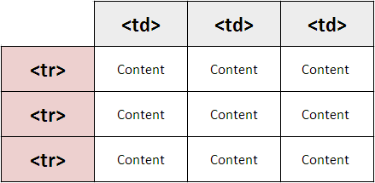

Slide 6
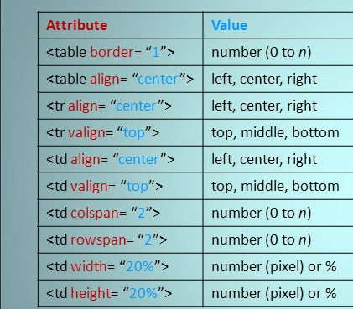
Attributes of Table tag
Used to merge Columns
Used to merge rows

Slide 7
